Slide 1
Update progress 2025/05/20 By: Krit ittisomboon (クリット イティソンブーン) (Hymn) (ヒム)

Slide 2
Progress
Collect Data of Echo Data near BKK/VTBS as a code.
Starting code of taking flight data.

Slide 3
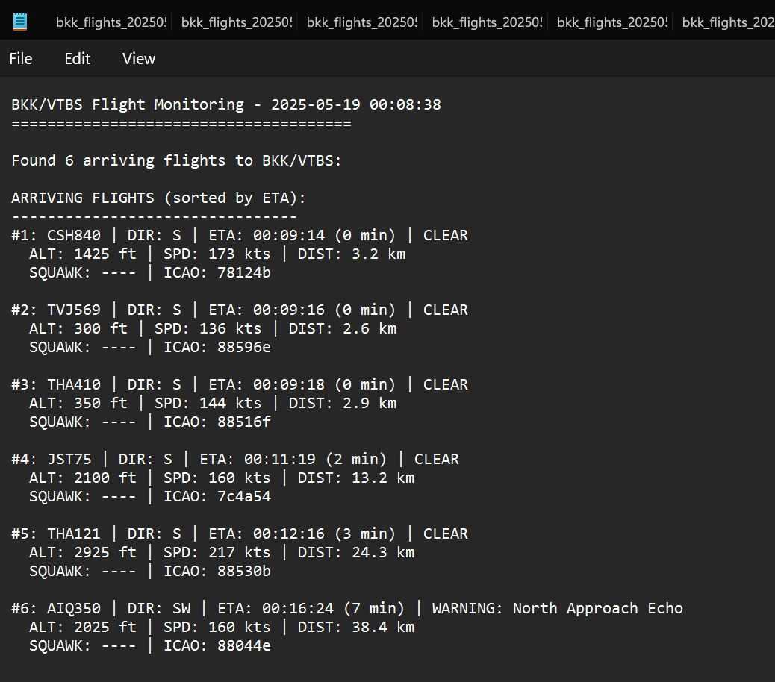
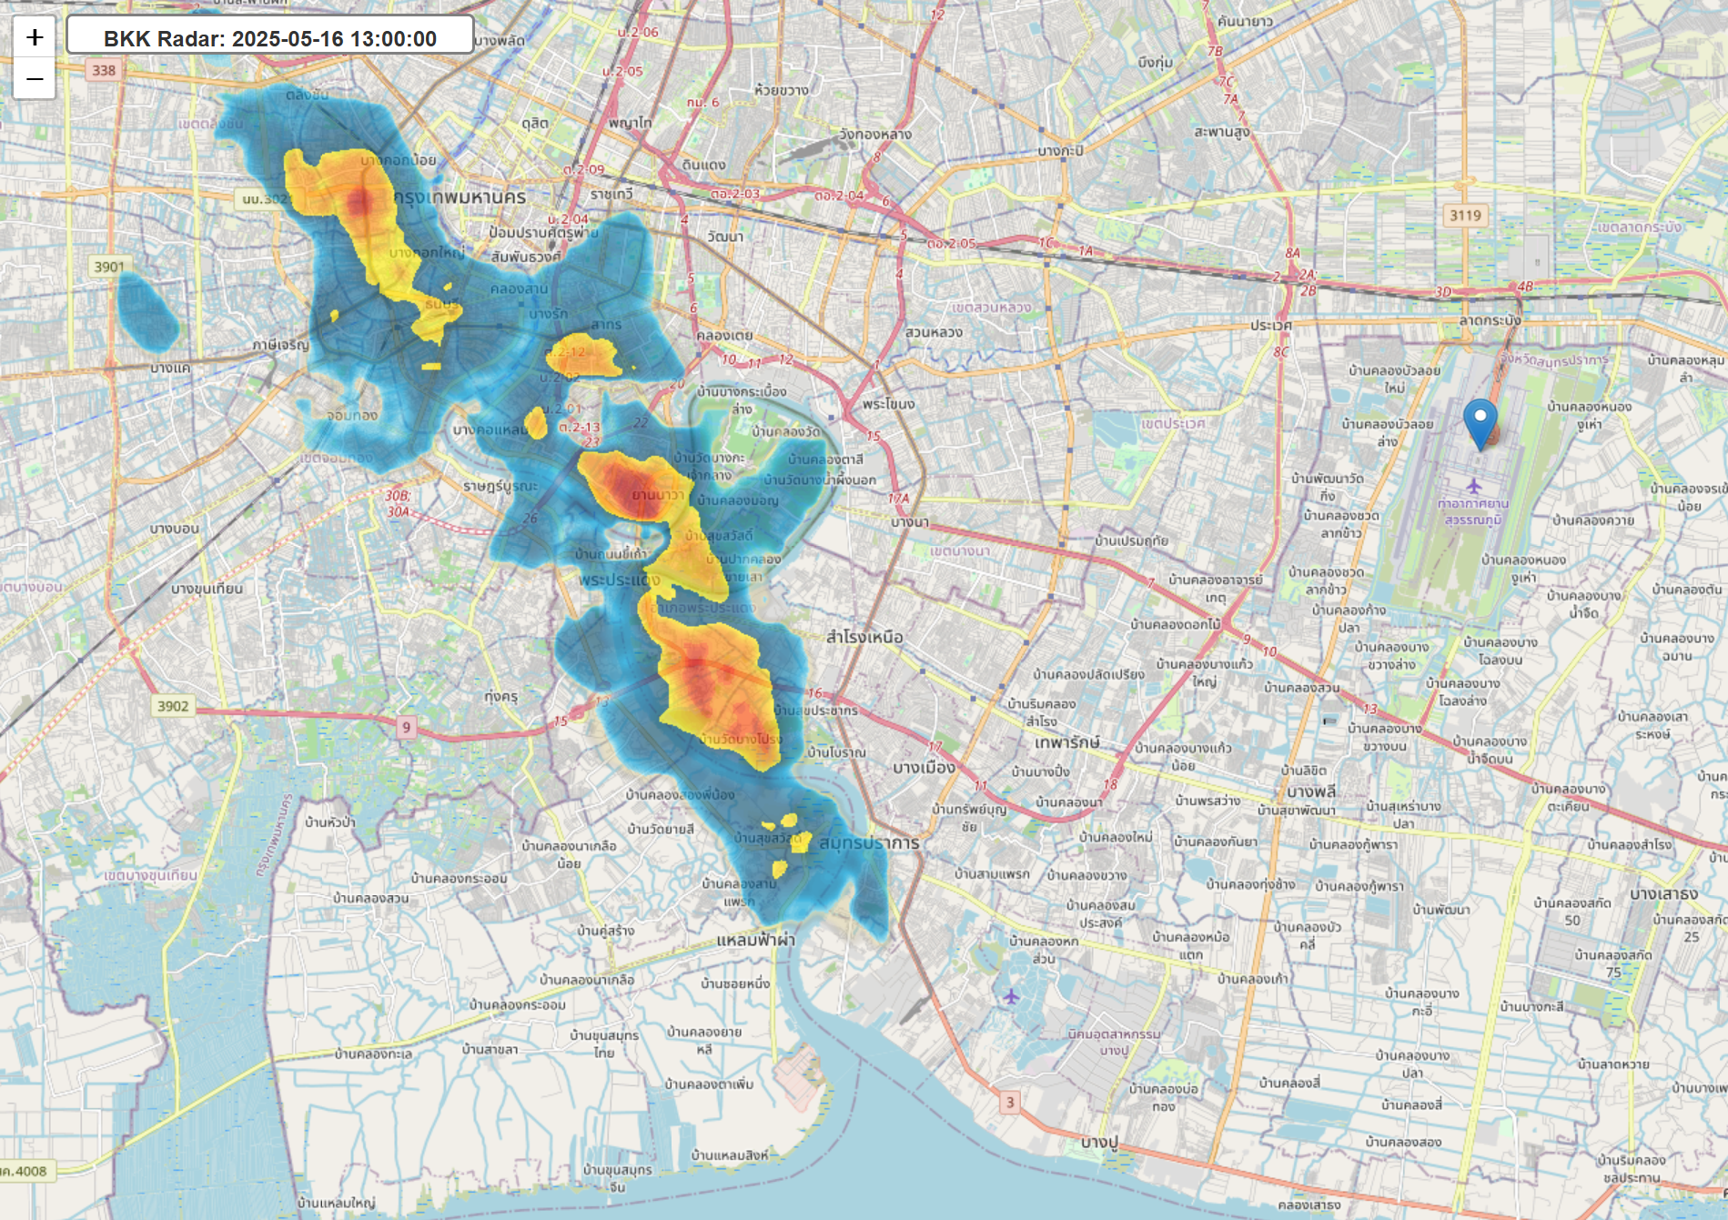
Result
Arrange Echo data as a file organized by date.
Code of echo data that retrieve data as a map but the data will lose in some few days.
Save flight arrivals data as JSON file and TXT file for easy reading.

Slide 4
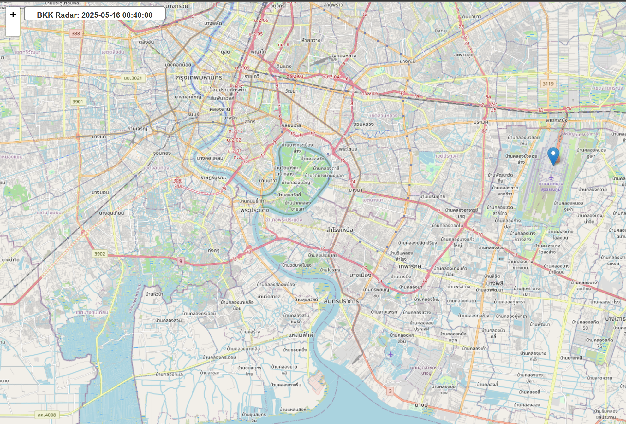
Problem
Saving Flight Data can be saved only real-time flight.
Echo Data lost when past some period of time.
We need to open the computer all the time to collect data because data need to be collect at real-time.
Some Flight data appears to be misunderstand (Ex. Mistake of arrival and departures)

Slide 5
Future work
Find how to take echo data all the time without opening computer all day long.
Fix of the lost of echo data.
Fixing code of taking flight data to get more accurate and precise.
Quantify qualitative weather avoidance decisions by pilots and air traffic controllers—such as measuring distance to weather echoes and deviations from flight paths.

Slide 6
Update progress 2025/05/26 By: Krit Ittisomboon (クリット イティソンブーン) (Hymn) (ヒム)

Slide 7
Progress
Create a Map of Thailand as CSV.
Taking Data of Echo weather (precipitation in Thailand).
Fix the data loss problem of the last week.

Slide 8
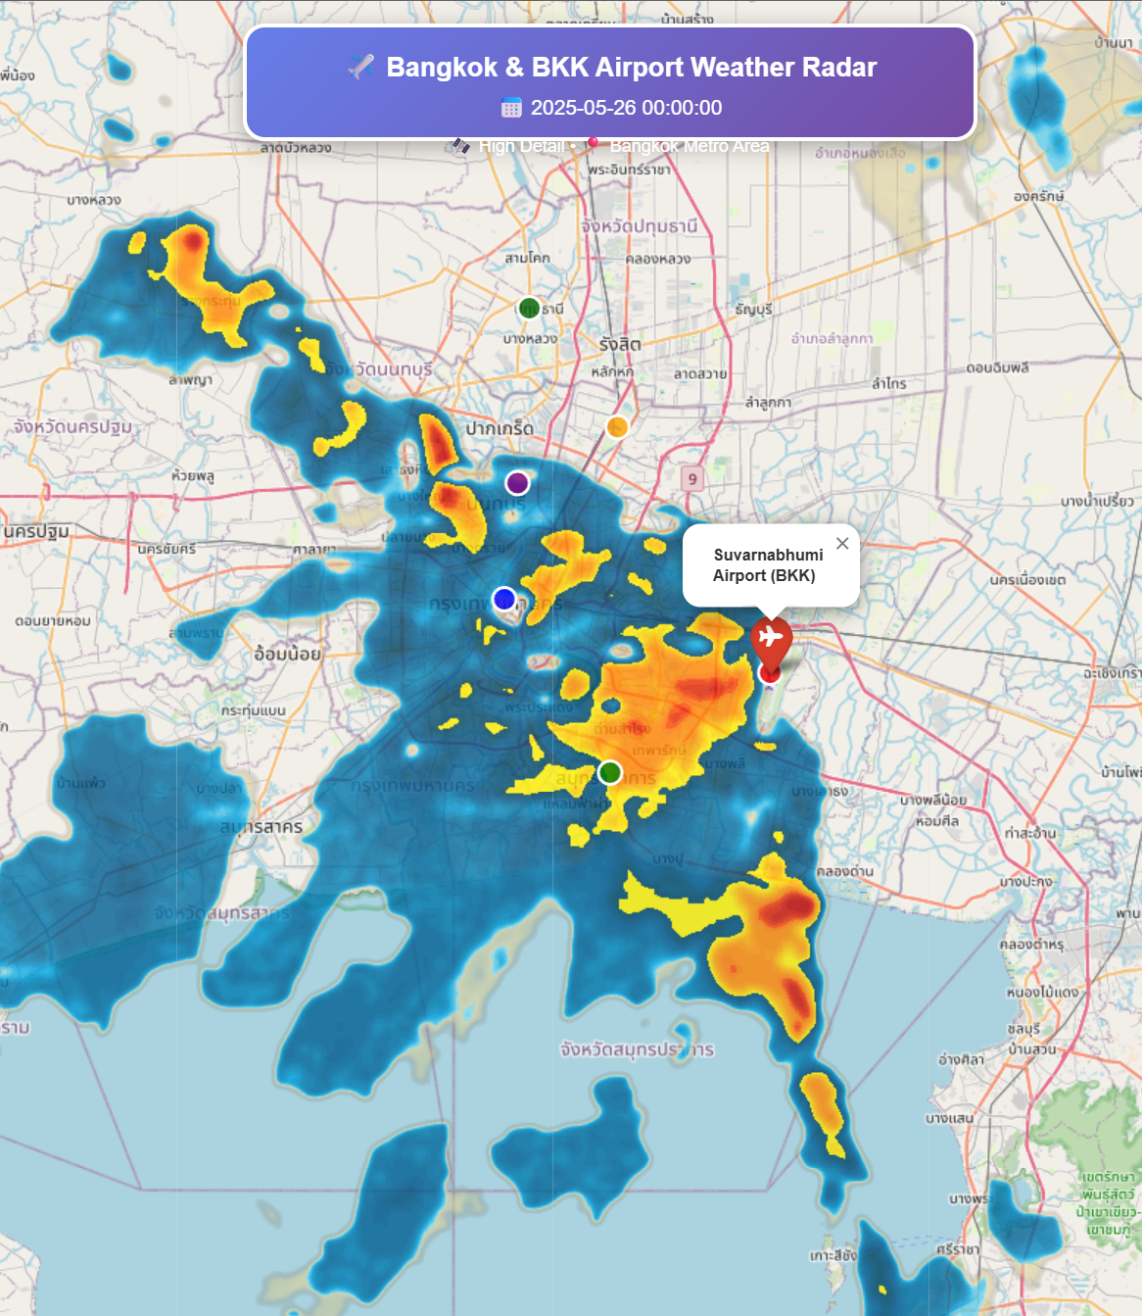
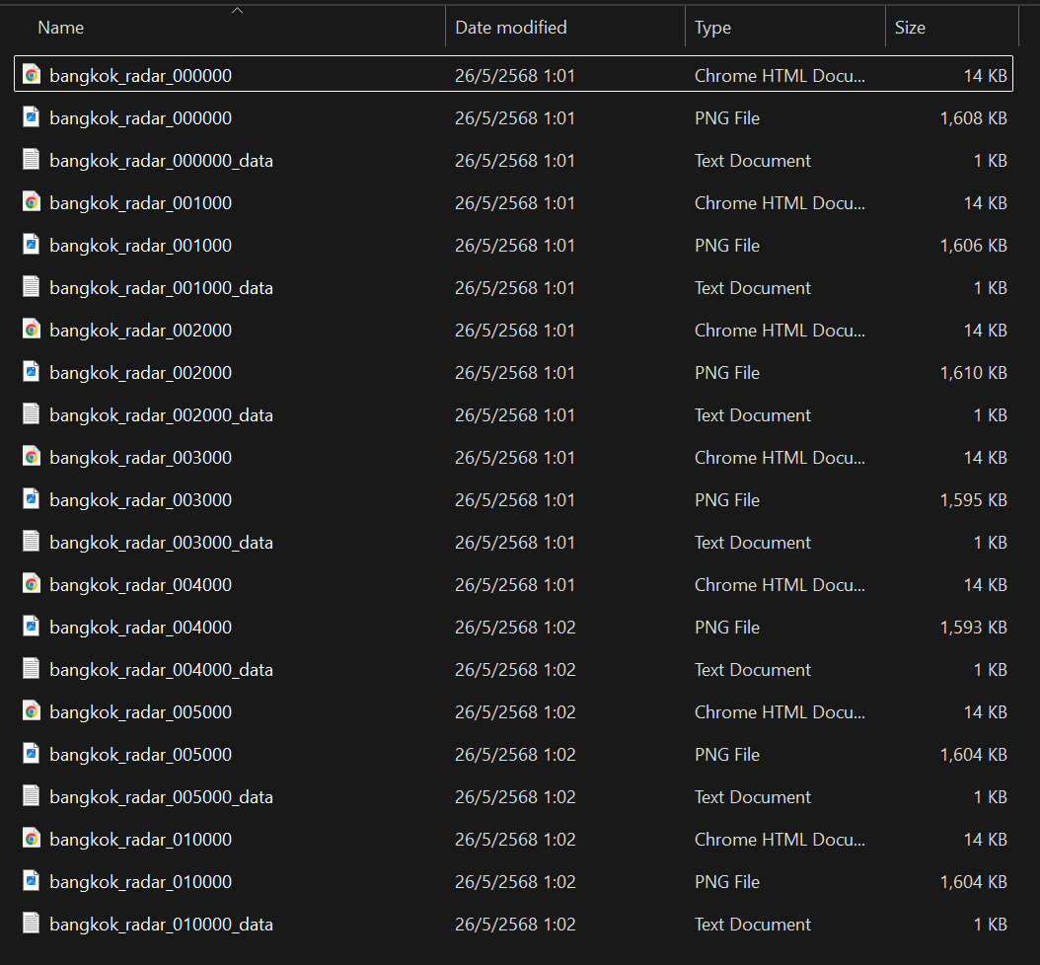
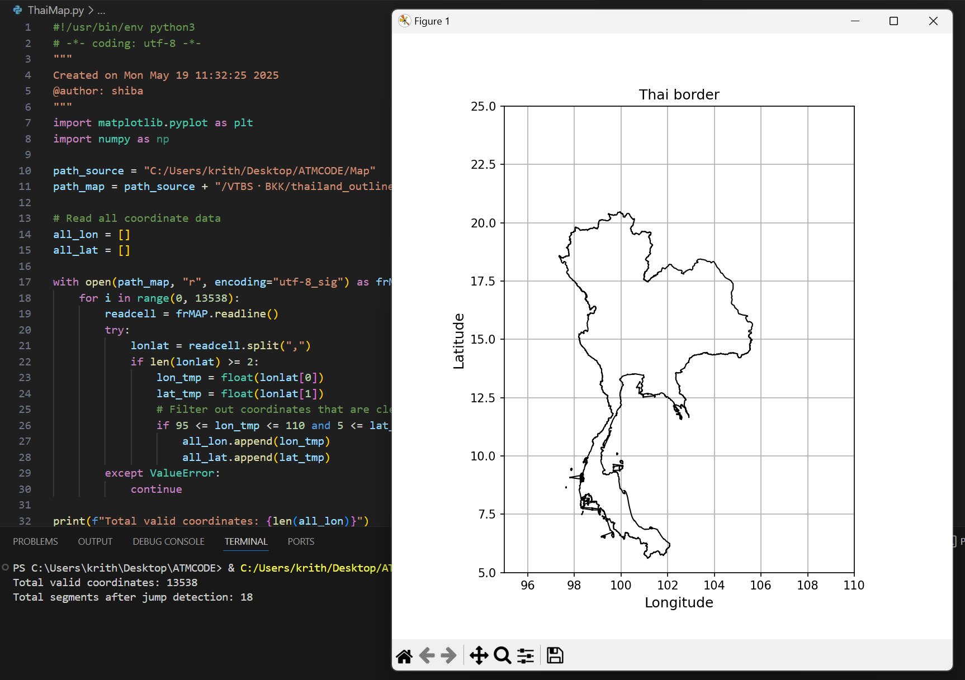
Result
The Map of precipitation we create doesn’t take from live APIs call from Rain-Viewer so when the time past our data lost. But we fix it to use the static map instead like taking screenshot so data still there.
I create a map as html file that can zoom in and out and a simple version of PNG
Map of Thailand Border to work on that later.

Slide 9
Problem
We need to open the computer all the time to collect data because data need to be collect at real-time or only past 2 hours.

Slide 10
Future work
Find how to take echo data all the time without opening computer all day long.
Focus on making code of taking flight data to get more accurate and precise.
Quantify qualitative weather avoidance decisions by pilots and air traffic controllers—such as measuring distance to weather echoes and deviations from flight paths.

Slide 11
Update progress 2025/06/02 By: Krit Ittisomboon (クリット イティソンブーン) (Hymn) (ヒム)

Slide 12
Progress
Run Code to collect echo data 24/7.
Merging 2 Code of Flight data collection and echo collection.
Creating Map with Flight on it.

Slide 13
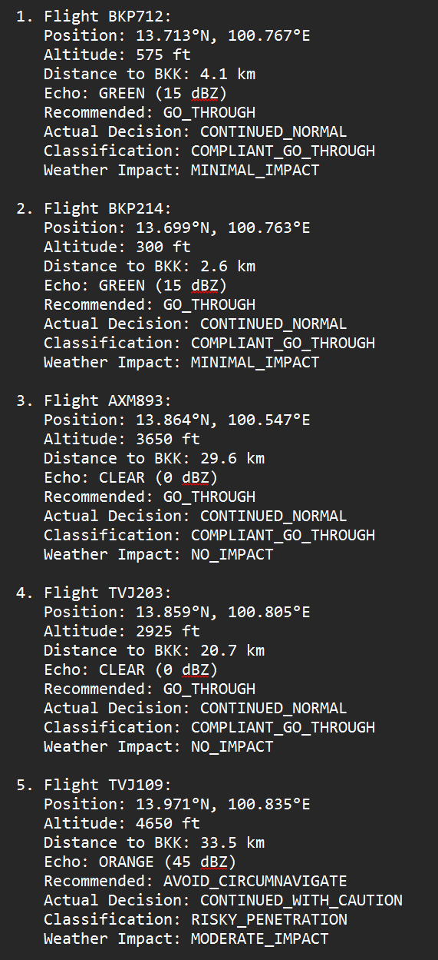
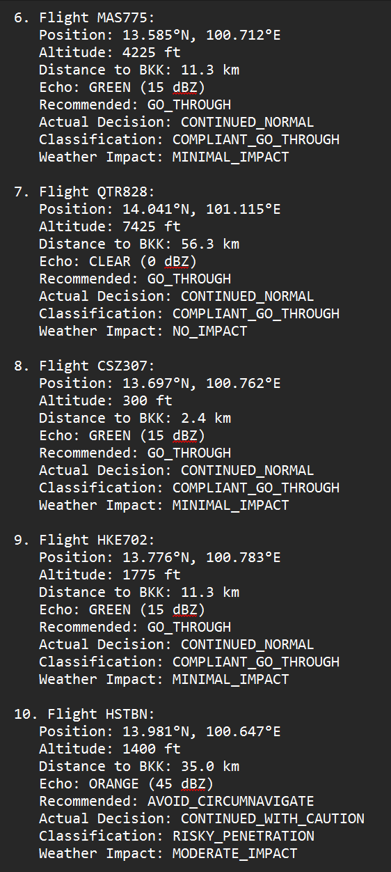
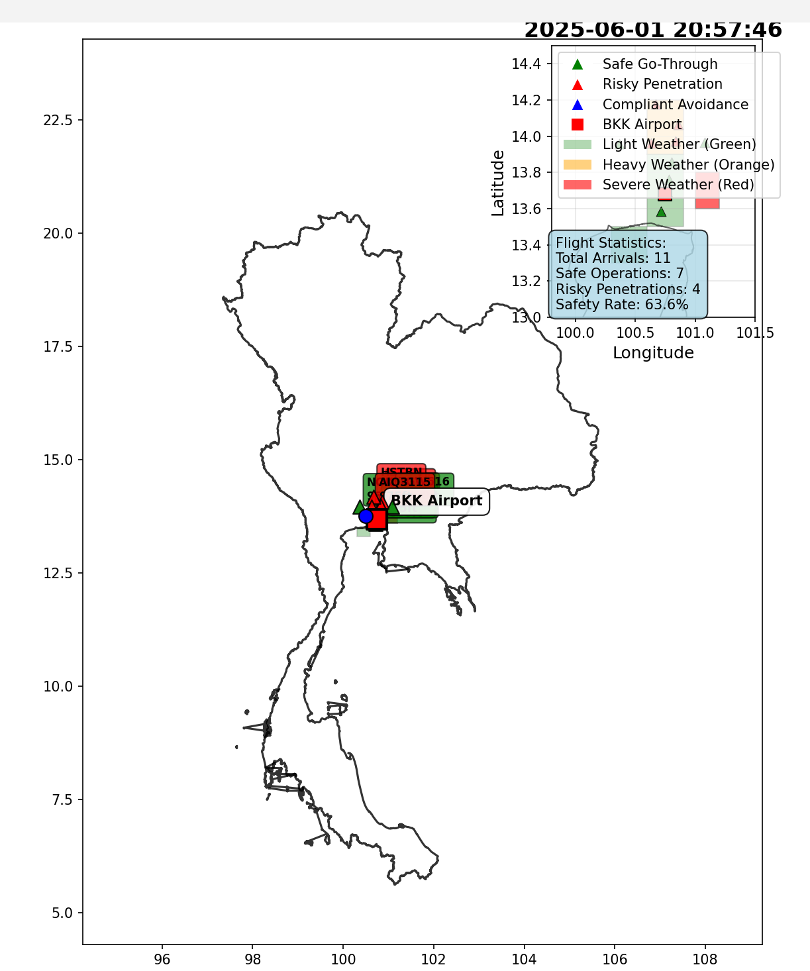
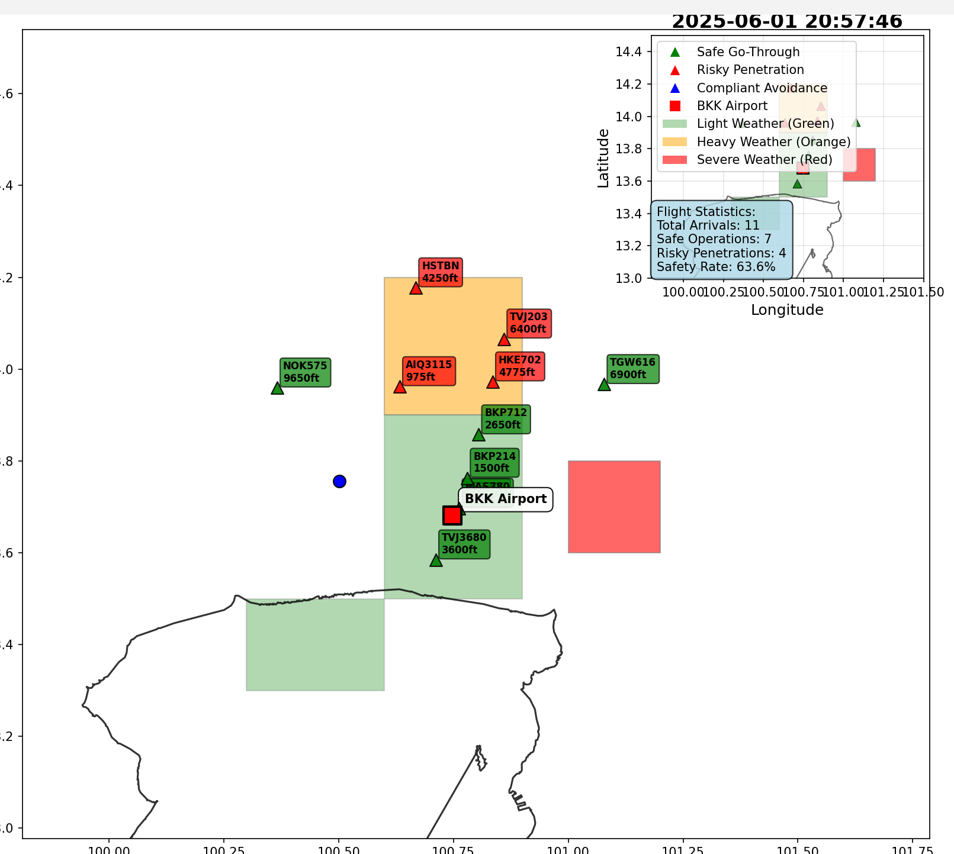
Result
Run the code to collect data all day long.
Merging 2 code of collect echo data and flight data to find data case that planes avoid or go through echo.
Create Map.csv to plot out the flight and echo.

Slide 14
Future work
Fixing Error.
Improve work.
Continue to do and gather data.
Echo Impact Analysis on Bangkok Airspace
ML-Based Route Generation Model.

Slide 15
Update progress 2025/06/16 By: Krit Ittisomboon (クリット イティソンブーン) (Hymn) (ヒム)

Slide 16
Progress
Find Wind Direction of the flight
Finding altitude of atmosphere

Slide 17
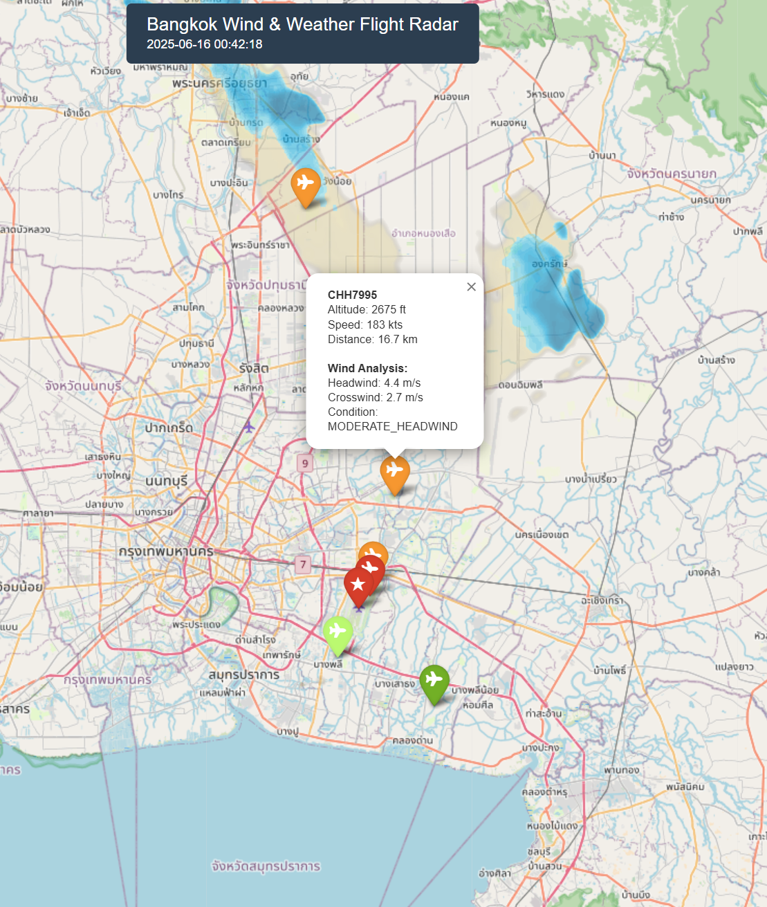
Result
I found the wind direction data and put it in to the map to recognize the flight that are flying with head-wind or tail-wind. Also find the altitude of the flight in that time also.

Slide 18
Problem
I try to merge the wind data code with the echo data code but the errors is too much so I separate it.

Slide 19
Future work
Try to fix the error so can be able to merge 2 code.
Find the METAR_Data
Finding the temperature at certain altitude of flight.

Slide 20
Update progress 2025/06/23 (Last) By: Krit Ittisomboon (クリット イティソンブーン) (Hymn) (ヒム)

Slide 21
Progress
Merge 2 Code Successfully of Wind Data and Weather Data.
Analyze the flight that got Head/Tail/Cross-wind or going through Echo by percentage of flight in that time period.

Slide 22
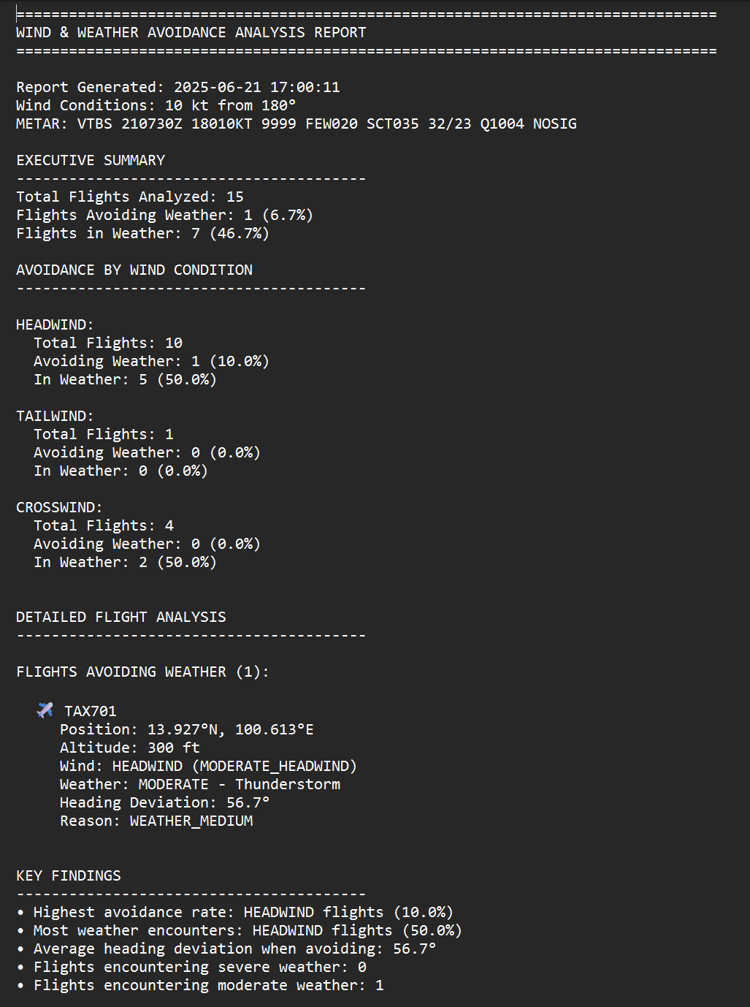
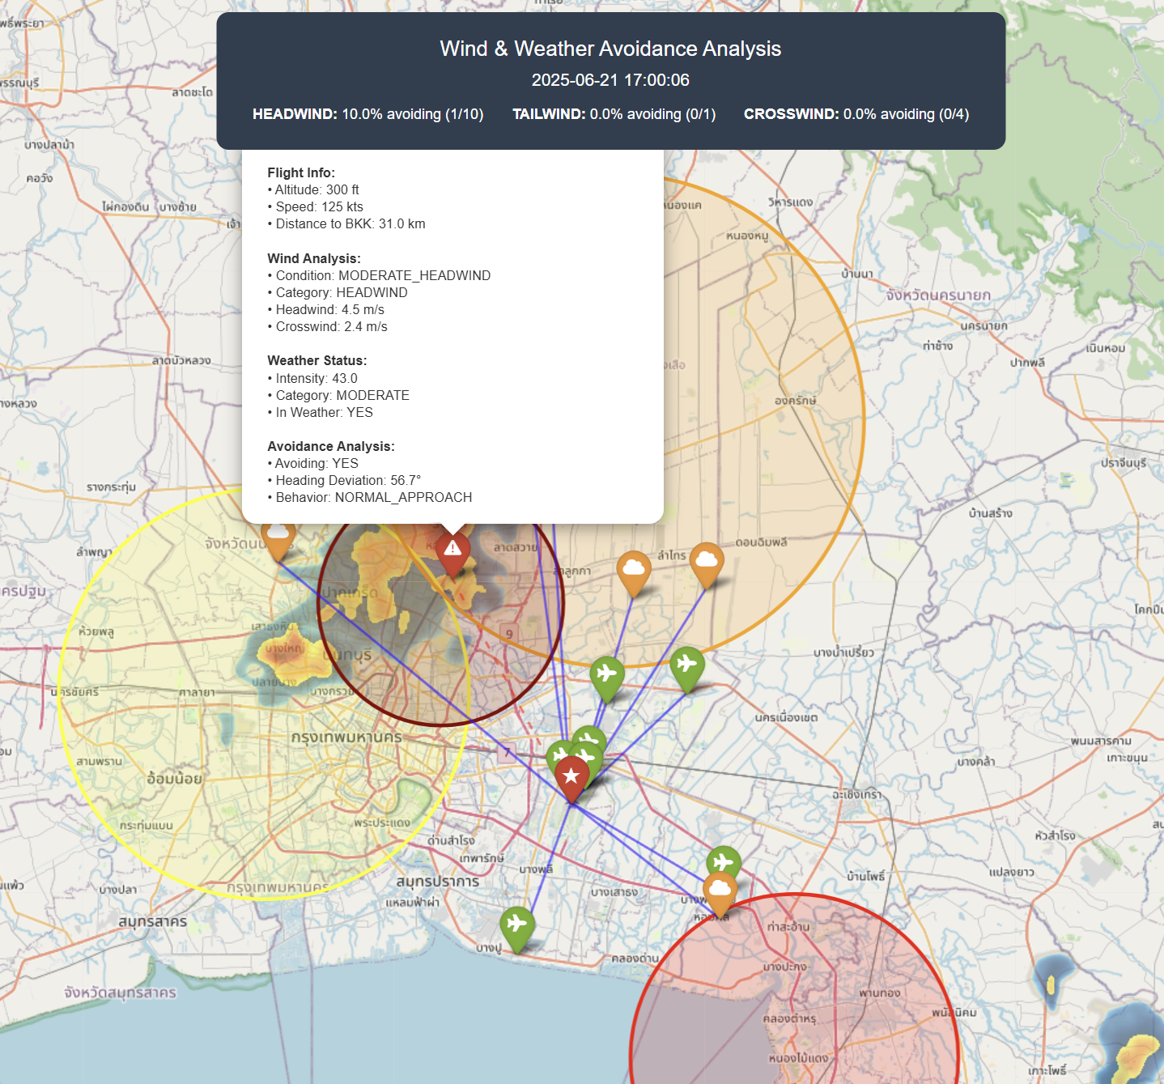
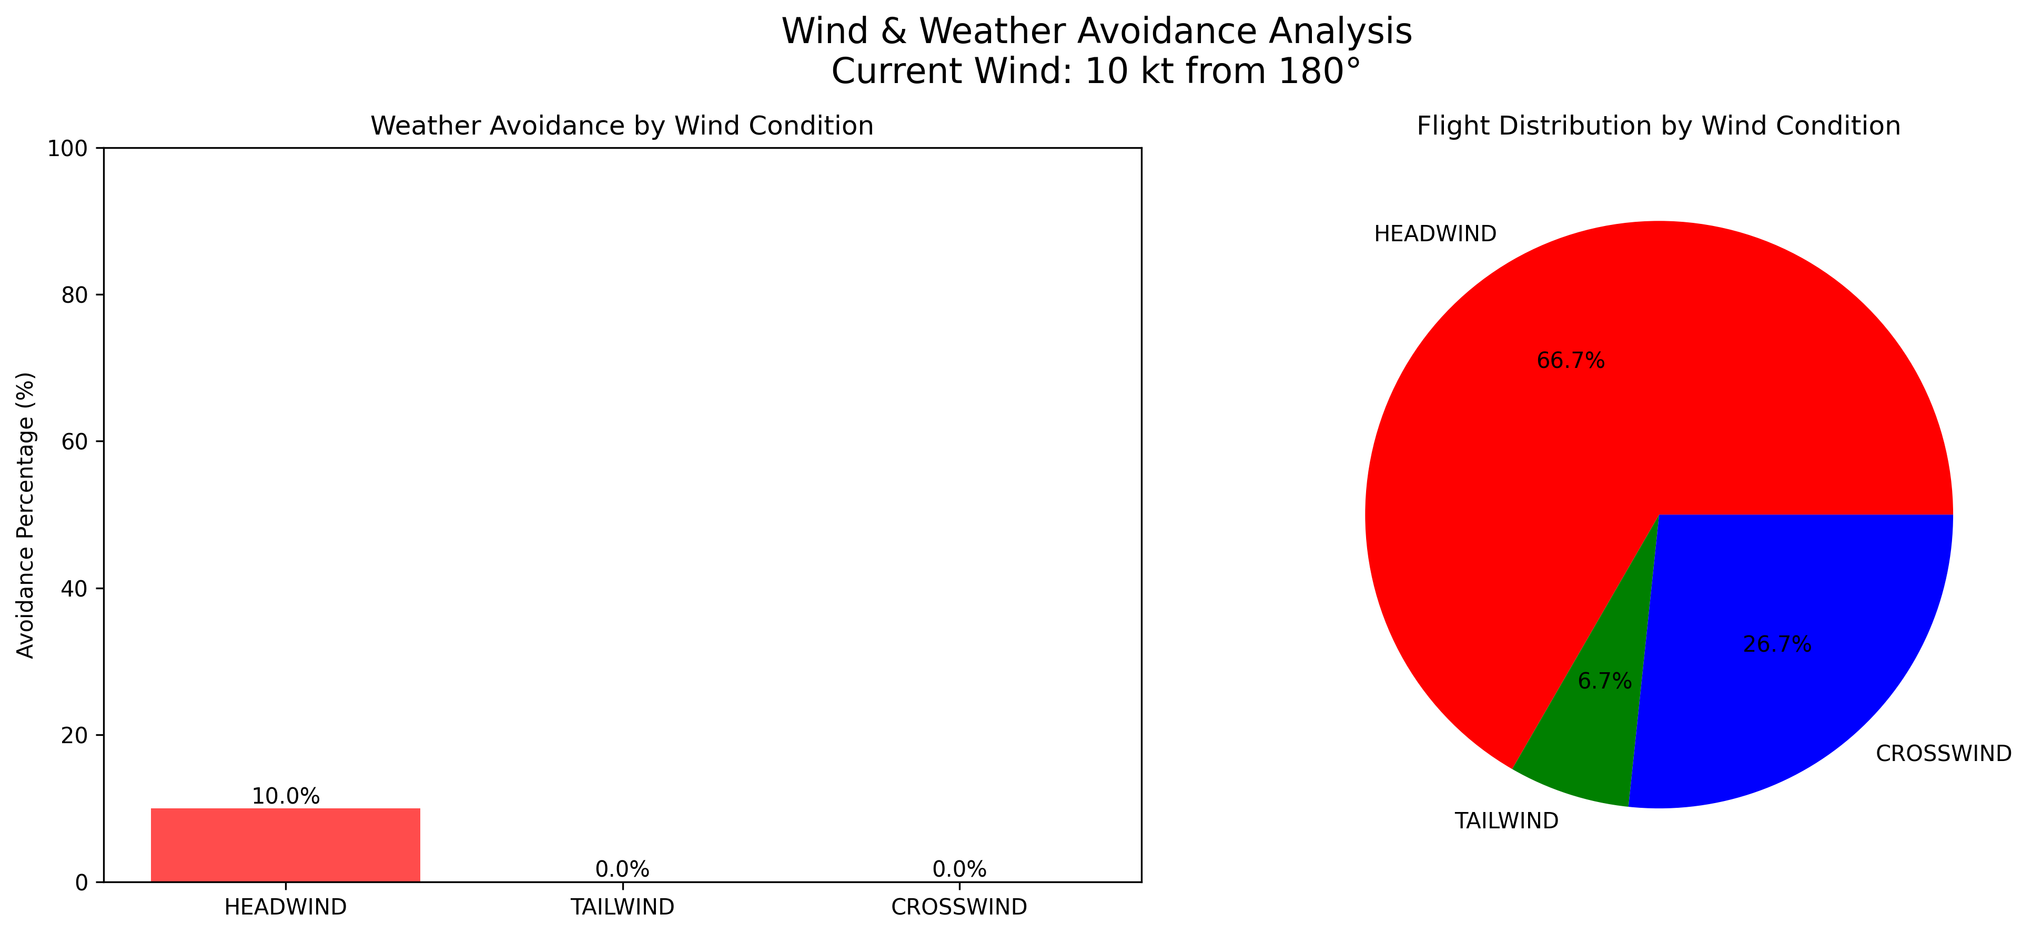
Result
Create a summary of the flight data at the time (real-time),since the APIs data we need to collect all the time. Create a map of full flight, wind and echo data using METAR data and Rain data from the RainViewer so we built an automated system that analyzes how wind conditions affect pilot weather avoidance decisions at BKK airport, achieving 60-70% detection accuracy with real radar data integration.

Slide 23
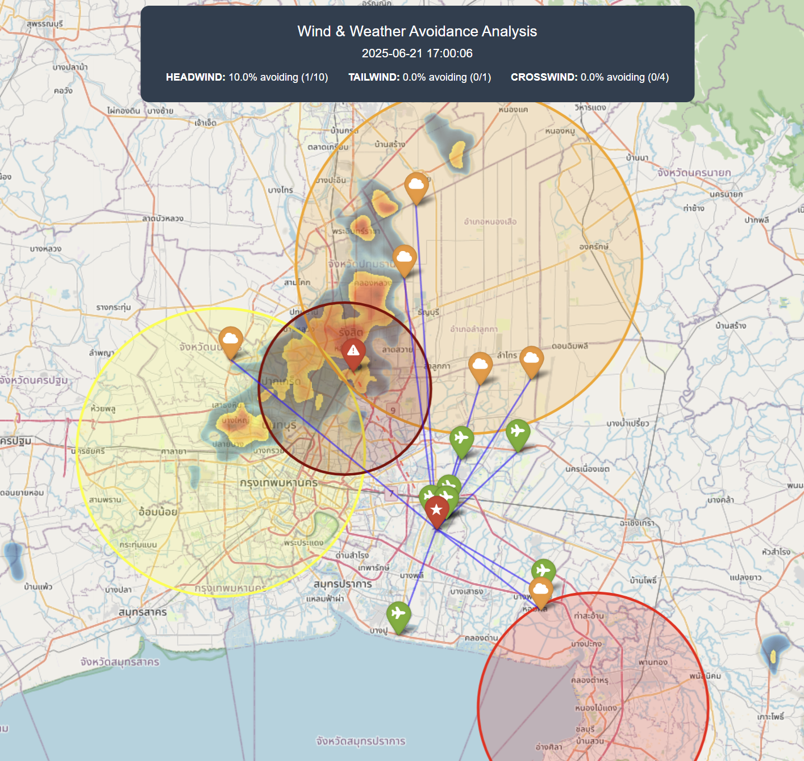
Problem
I forgot to delete the color circle in the map it was fixed echo data I manually input.
The code can’t classify between “Weather Avoidance” and “Standard Procedures”
Flight Radar data not complete since we didn’t got enough data from free API.
Missed High-Altitude Operations
Flight over FL200+ analyze incorrectly
Overflying weather count as “In Weather”

Slide 24
Future work
Remove the color circle I manually input.
Altitude Filtering
We need Flightradar24 API to get complete flight data
Ex. Historical Flight Path, Heading/Tracks and we can compare the planned path with actual route.
Add Confidence Scoring so we can know which data will be more accurate.
Plotting Flight Path on the map for better understanding.

